Slide 1
Data Pipelines for
Large Datasets
John Thickstun

Slide 2
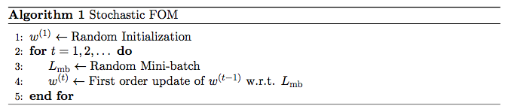
First-Order Method Template

Slide 3
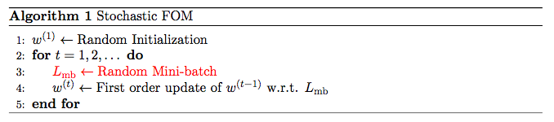
First-Order Method Template

Slide 4
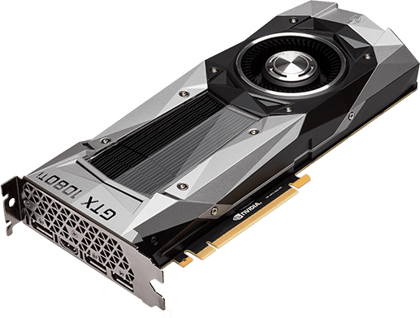
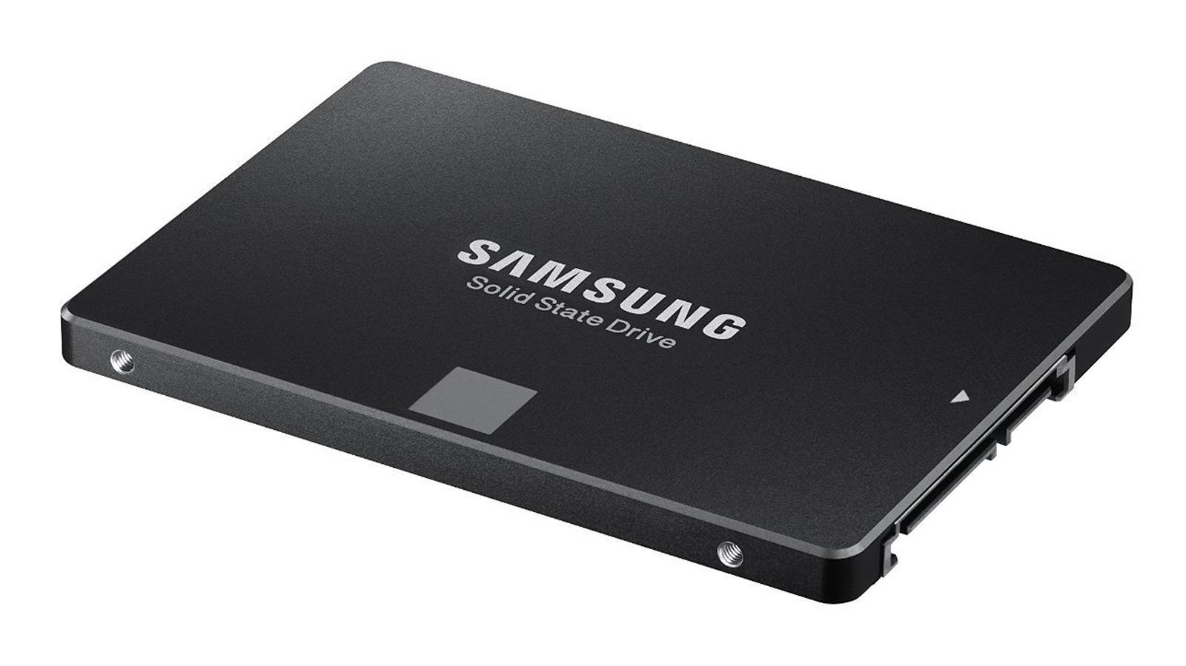
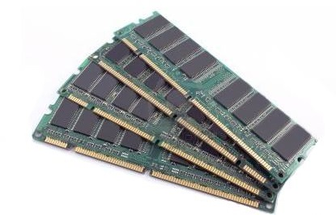
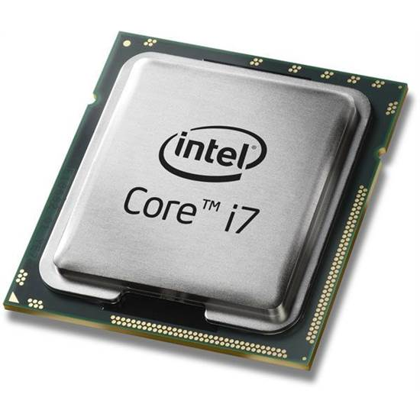
Data Pipelines
SATA 3
PCIe

Slide 5
Retrieving a Random Mini-batch
Is your dataset...
< 1GB?
Store it on the GPU

Slide 6
Retrieving a Random Mini-batch
Is your dataset...
< 1GB?
Store it on the GPU
< 128GB?
Store it in system RAM

Slide 7
Retrieving a Random Mini-batch
Is your dataset...
< 1GB?
Store it on the GPU
< 128GB?
Store it in system RAM
< 512GB?
Strongly consider storing it in system RAM

Slide 8
Retrieving a Random Mini-batch
Is your dataset...
< 1GB?
Store it on the GPU
< 128GB?
Store it in system RAM
< 512GB?
Strongly consider storing it in system RAM
O(Terabytes)?
Training will be painful

Slide 9
Data Pipelines
SATA 3
40 PCIe lanes
600MB/s
8x 1GB/s

Slide 10
Retrieving a Random Mini-batch
Upper bound: how big is your minibatch?

Slide 11
Retrieving a Random Mini-batch
Upper bound: how big is your minibatch?
ImageNet?
Commonly resampled to 256x256 (x3)
Suppose we use mini-batch size of 100
Each minibatch is ~75MB
You can read no more than ~8 mini/second

Slide 12
Retrieving a Random Mini-batch
Upper bound: how big is your minibatch?
ImageNet?
Commonly resampled to 256x256 (x3)
Suppose we use mini-batch size of 100
Each minibatch is ~75MB
You can read no more than ~8 mini/second
Multiple concurrent experiments?
Minibatch rate drops by factor # of experiments

Slide 13
Multiple concurrent experiments
Data Client
Get batch from socket
Data Server
Data Client
Main thread
Reads disk
Fills queues
Client threads
Serve data to client from queue over socket
Get batch from socket
Data Client
Get batch from socket
Data Client
Get batch from socket

Slide 14
Concurrent experiments (round 2)
Data Client
Read from “disk”
...
Linux pagebuffer
Data Client
Read from “disk”
Works if you can fit a single complete copy of your dataset in RAM
Monitor with free -m
buff/cache tracks the size of the pagebuffer
Clear the pagebuffer (useful for debugging):
sudo sh -c 'echo 1 >/proc/sys/vm/drop_caches'

Slide 15
Final Random Thoughts
For measurements, it’s useful to eat up all your RAM:
memory_eater = ' ' * 56*(2**30)
This effectively disables the pagebuffer

Slide 16
Final Random Thoughts
For measurements, it’s useful to eat up all your RAM:
memory_eater = ' ' * 56*(2**30)
This effectively disables the pagebuffer
Seek times aren’t O(1)!
SSDs advertise O(1) seek time (for example .1ms)
But filesystems store files in fragments
One call to ‘seek’ corresponds to many SSD seeks
Consider storing your data on an empty partition?

Slide 17
Final Random Thoughts
For measurements, it’s useful to eat up all your RAM:
memory_eater = ' ' * 56*(2**30)
This effectively disables the pagebuffer
Seek times aren’t O(1)!
SSDs advertise O(1) seek time (for example .1ms)
But filesystems store files in fragments
One call to ‘seek’ corresponds to many SSD seeks
Consider storing your data on an empty partition?
Consider using multiple SSDs?

Slide 18
Final Random Thoughts
For measurements, it’s useful to eat up all your RAM:
memory_eater = ' ' * 56*(2**30)
This effectively disables the pagebuffer
Seek times aren’t O(1)!
SSDs advertise O(1) seek time (for example .1ms)
But filesystems store files in fragments
One call to ‘seek’ corresponds to many SSD seeks
Consider storing your data on an empty partition?
Consider using multiple SSDs?
Has anyone tried SATA Express?

